Slide 1
Our Star, the Sun
Oscillations

Slide 2
Activity I: naked eye
How to build a physical model of the sun
Activity II: energy bill
How to build a physical model of the sun
Sources of energy in the sun
Module I: Our star, the sun
Activity III: oscillations
The vibrational properties of physical bodies are related to
their internal structure and dynamics
The sun and other stars vibrate/oscillate
Activity IV: solar and
stellar oscillations
To measure solar and stellar oscillations
To extract information on the solar internal structure from its
oscillatory properties
To learn how to move from the time-domain to the frequency-domain

Slide 3
Activity III
Oscillations

Slide 4
Oscillations
Outline
Fast facts
Students will learn
Curricular connections
Resources
Implementation

Slide 5
Outline
This set of activities are intended to explain the connection between the vibrational patterns of an object and its internal structure and dynamics.

Slide 6
Fast facts
Age range: Secondary
Type of module: Classroom activity
General Curriculum links: All areas of science
Complexity: Medium
Time required: 3-4 class sessions
Location: Classroom
Includes the use of: Computer
Methodology: Direct instruction and hands on

Slide 7
Students will learn
The basics of the scientific method
To look for patterns in nature
How a physical model is built
Use concepts like: oscillations, frequency, resonance, …

Slide 8
Resources
Computer and projector
Software to present slides (ppt or similar)
Smartphone
Google Science Journal app, Audacity
Wooden stick, screws, string, masses, protractor, pvc tubes, rulers

Slide 9
The activities
The pendulum: understand the concept of oscillation, frequency and the relationship between spatial parameters of the pendulum and its frequency of oscillation
Introducing time series
Coupled pendulums: understand the concept of resonance
Monochord: resonance in strings and the relationship between physical parameters of the string and its frequency of oscillation (vibration)
PVC tubes: to infer size of a PVC tube from its resonance frequency and to infer sound speed in the air from the sound emitted by an open PVC tube

Slide 10
Frequency and period
Pendulum
Oscillations
Relation between oscillator structure and oscillation properties
Introducing
time-series
Represent oscillations in terms of time-series
Basic analysis of time-series with Google Science Journal
Coupled pendulums
Resonance
Activity III: oscillations
Sound is a type of vibration/oscillation
Standing wave, harmonics in 1D
Monochord
Basic analysis of time-series with Google Science Journal
Relation between oscillator structure and oscillation properties
Standing wave, harmonics in 2D
PVC tubes
Basic analysis of time-series with Audacity
Relation between oscillator structure and oscillation properties

Slide 11
The pendulum
With this activity we introduce the concept of oscillation, that is, a movement that repeats cyclically
We will use a pendulum, more specifically a plumb line
Students will answer the following question: does the oscillation period (or frequency) of the pendulum depend on the length of the thread and/or the mass of the plumb bob and/or the angle from which the pendulum starts moving?
Students are asked to give answers (hypothesis) before starting the experiment

Slide 12
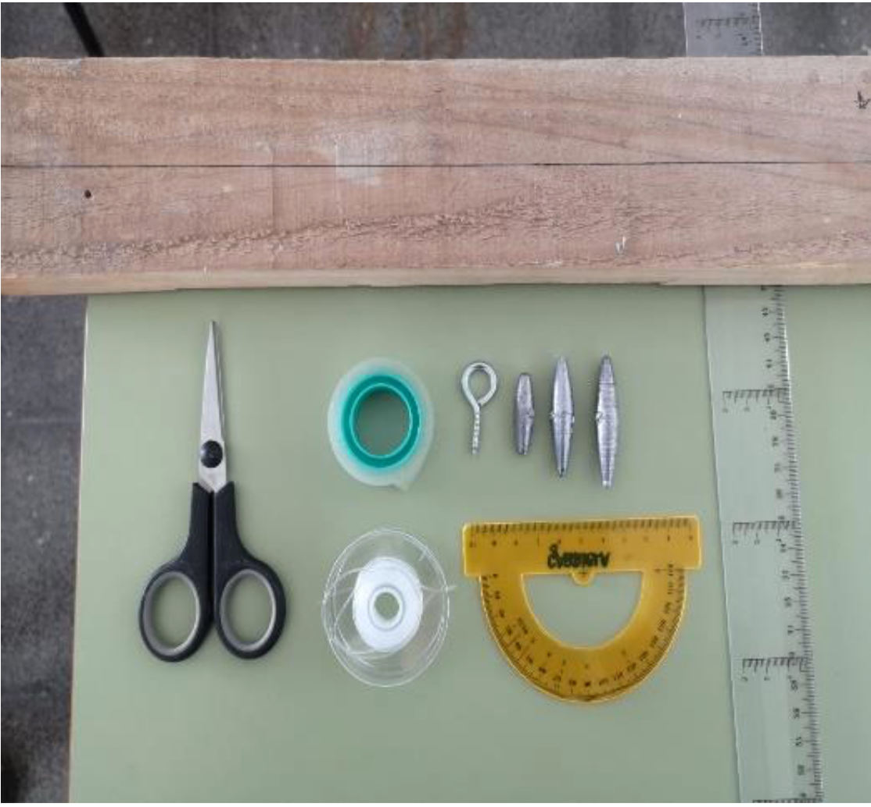
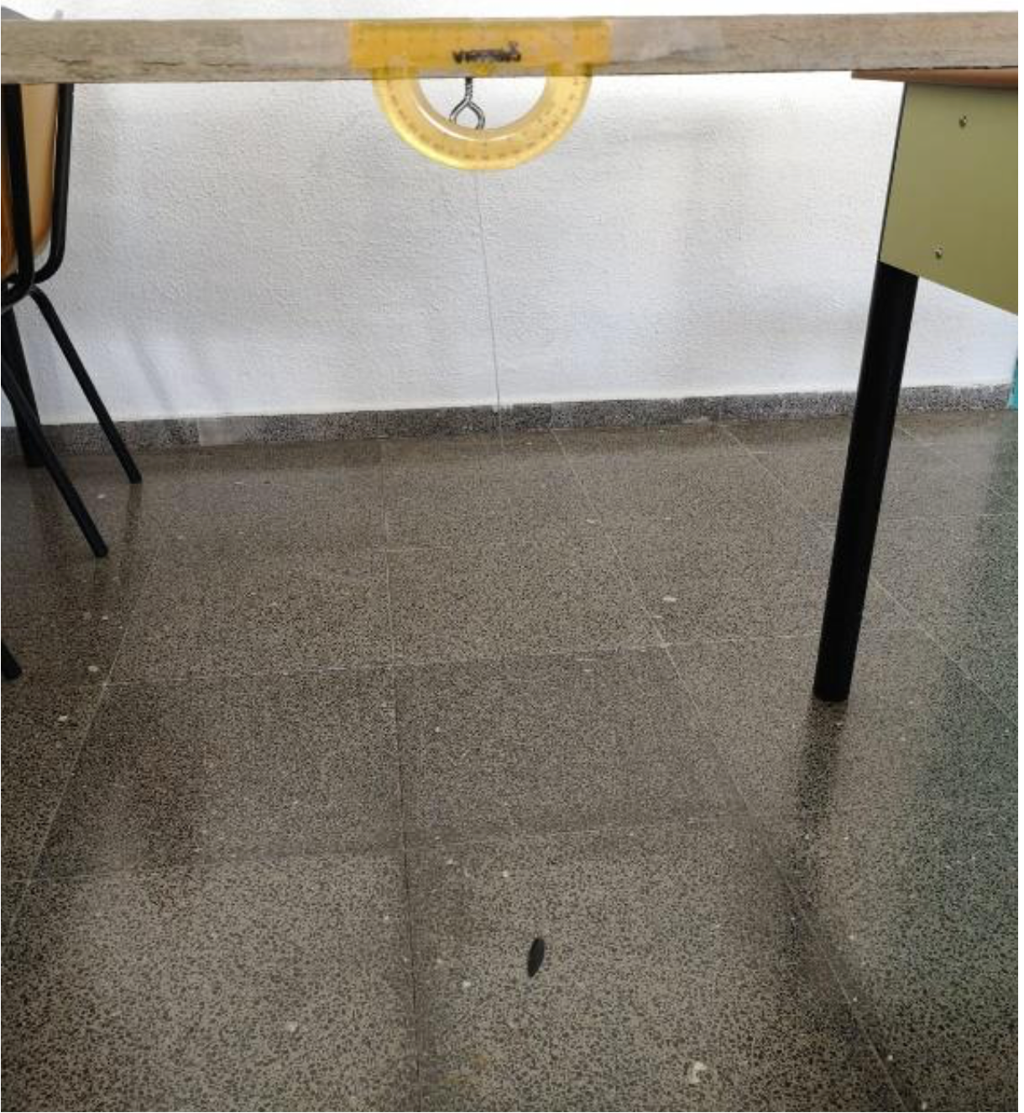
The pendulum
Students are provided with different weights, a thread roll, protractor, ruler, a wooden stick, fixing screws and scissors
They are asked to set up the experiment to measure initial angles, period of oscillation, length of the thread, …

Slide 13
The pendulum
Students are provided with different weights, thread roll, protractor, ruler, a wooden stick, fixing screws and scissors
They are asked to set up the experiment to measure initial angles, period of oscillation, length of the thread, …
It is important to stress out the importance of repeating several times every measurement in order to obtain mean values and statistical errors
It is also important to ask students to modify only one parameter (e.g. thread length) at a time, while leaving the others fixed.
In this sense, students should measure the oscillation period (or frequency) for thread lengths ranging from 5 to 55 cm in steps of 5 cm, repeating at least 5 times every measurement. The weight of the bob and the initial angle must be fixed (e.g. 50 g and 45º)

Slide 14
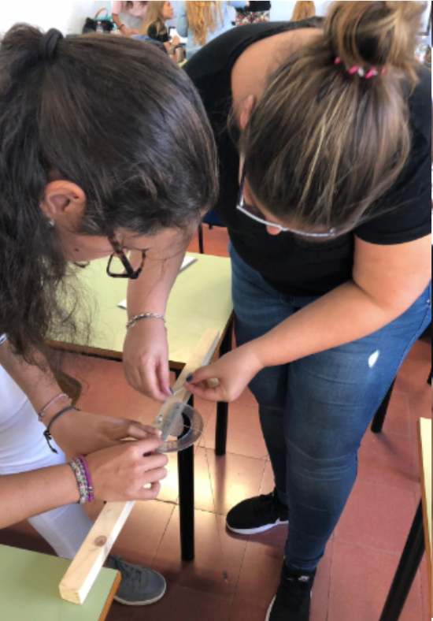
The pendulum
Once the effect of length is measured, the independent variable is changed, e.g. the weight of the bob. Ten different weights could be tested, leaving the initial angle and the length of the thread fixed. When this is done, the initial angle is tested, leaving the length of the thread and the weight of the bob fixed.
Once all the data are tabulated, students are asked to make graphs, by hand (avoid excel or any other software). In this way, you can check the ability of your students in making graphs.

Slide 15
The pendulum
From these graphs, it will be obvious that the oscillation of the pendulum depends only on the length of the thread. Students may find correlations between the period of oscillations and the weight of the bob or the initial angle. Teachers are encouraged to show the students that these likely correlations fall below the error of the measurements. Stress out these is one of the reasons we repeat every experiment several times; otherwise we won´t have a good inference of the measurement errors.

Slide 16
The pendulum
This is a very easy-to-set-up experiment, where we introduce the idea of oscillations, frequency and period
It is an ideal experiment to stress out the importance of the robustness of the measurements and the importance of error control
We also test the ability of the students to organise data, make graphs and make good interpretations

Slide 17
The pendulum
The period or frequency of oscillation of the pendulum depends on one structural variable, in this case, the length of the pendulum thread

Slide 18
Introducing time-series
This activity will introduce students to the mathematical analysis of time-series
We are going to repeat the ‘pendulum’ activity, but at this time in terms of time-series analysis
Let´s hang a smartphone at one end of a 100 cm (or any other length) thread. The smartphone becomes the line plumb bob.
We are going to record the y-axis acceleration during 15 seconds, while the smartphone is oscillating. Google Science Journal will be used to record the acceleration and build the time-series
At the same time we will measure the oscillation period, as it was done in the previous activity.

Slide 19
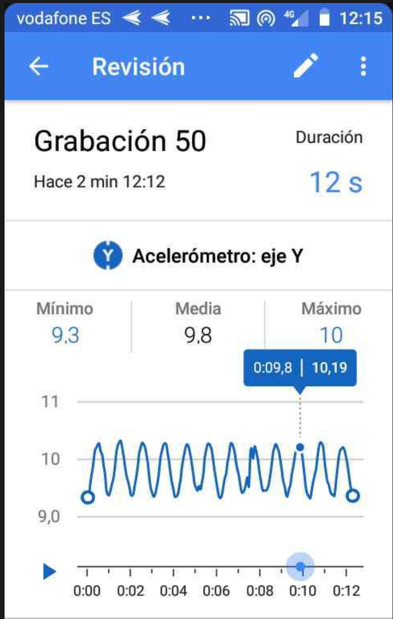
Introducing time-series
The image shows the data recorded by Google Science Journal: the variation in vertical acceleration as a function of time. The ups and downs correspond to the swinging of the smartphone. We hence translate the ‘visual’ swinging into a time-series.
If we measure the time interval between two consecutive ups or downs, we will obtain the period of oscillation of the pendulum, in this case 1 s. The same result was obtained by measuring ‘by eye’ the period of oscillation as it was done in the previous activity

Slide 20
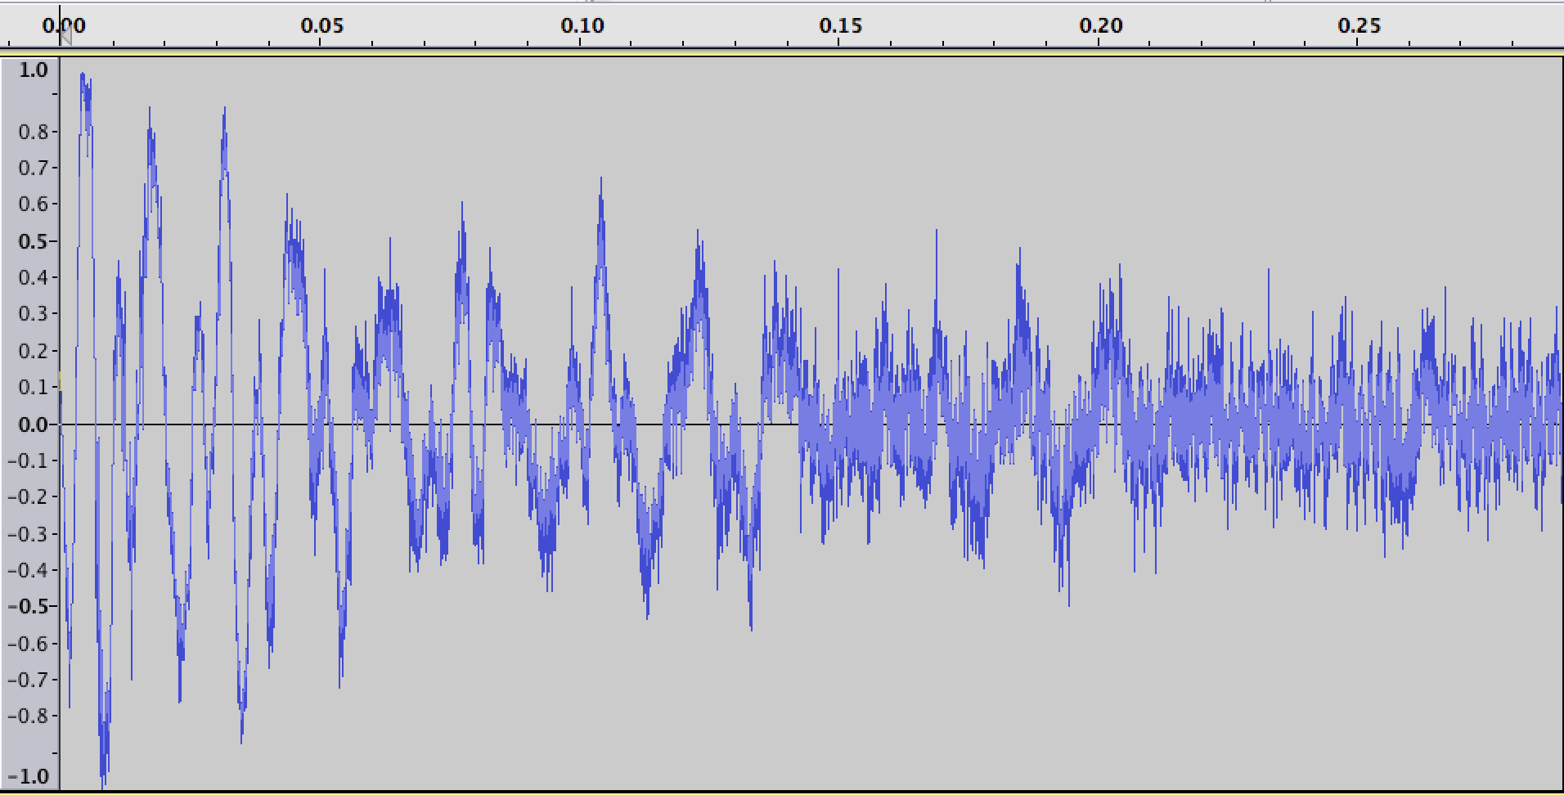
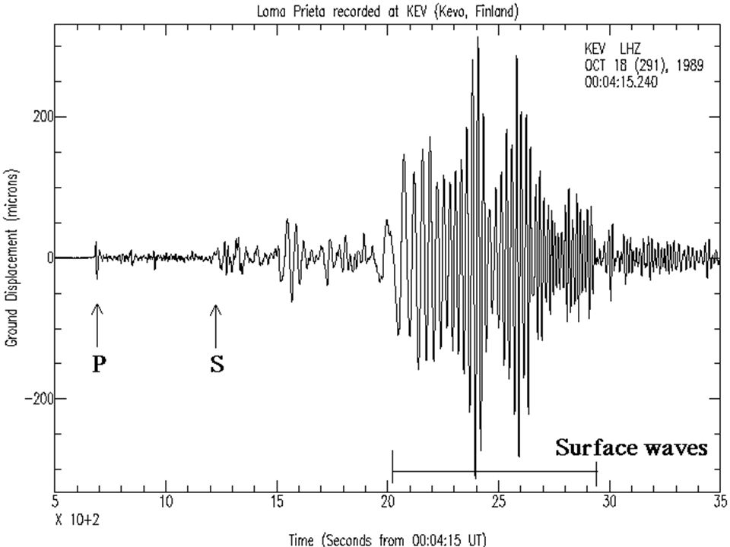
Introducing time-series
The time-series of a pendulum is quite simple (a damped sine); however, time-series of oscillating or vibrational phenomena could be extremely complex (sound, seismic record, …), as shown below
Sound record
Seismic record

Slide 21
Introducing time-series
Time series is the most common way to represent oscillatory or vibrational phenomena. There are specific mathematical tools to analyse time-series and to extract information from them

Slide 22
The coupled pendulum
In the previous activity, we use a wooden stick to hang a pendulum. Let´s use the same stick to hang three pendulums with different thread lengths (e.g. 20, 40 and 55 cm)
We propose a challenge to the students. They should try to swing one of the three pendulums (the other two should be almost still). There are only allowed to touch or move the stick.
This challenge is resolved by swinging or turning the stick rhythmically at the same frequency as the pendulum in question.

Slide 23
The coupled pendulum
When the stick is swinging at the same frequency as the pendulum, we are constructively injecting energy into the pendulum. It can be seen that the amplitude of oscillation of the pendulum significantly increases.
The injection of energy into the other two pendulums is not efficient and their amplitude of oscillation does not increase.
This phenomenon is called resonance and consists in amplifying the oscillatory movement of a body by injecting energy at its oscillation frequency.
Resonance explains why musical instruments are heard, the swinging of buildings during earthquakes, …

Slide 24
The coupled pendulum
It is possible to amplify the oscillatory movement of a body by resonance, that is by injecting small amounts of energy at the oscillation frequency of the body

Slide 25
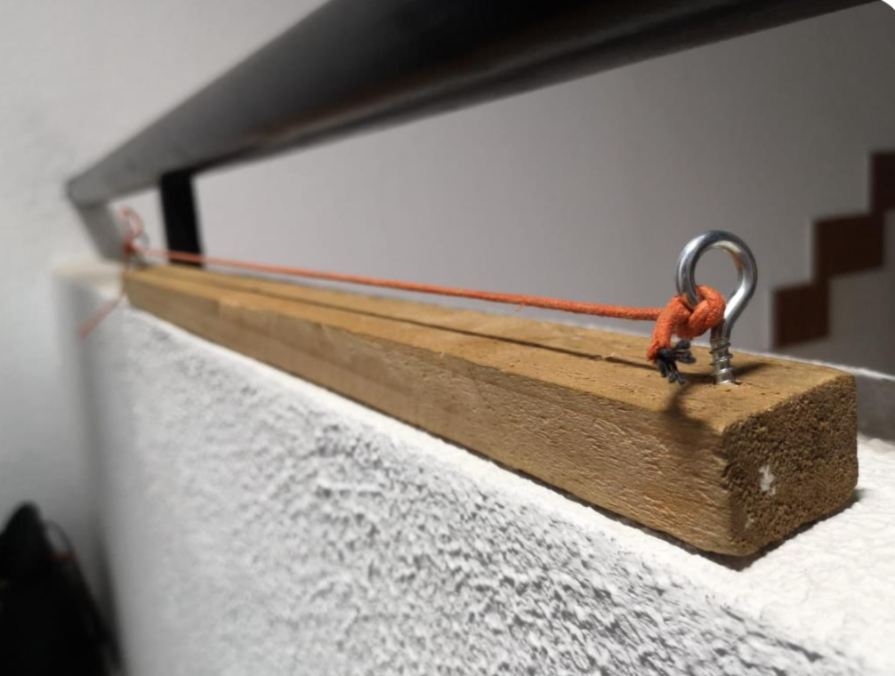
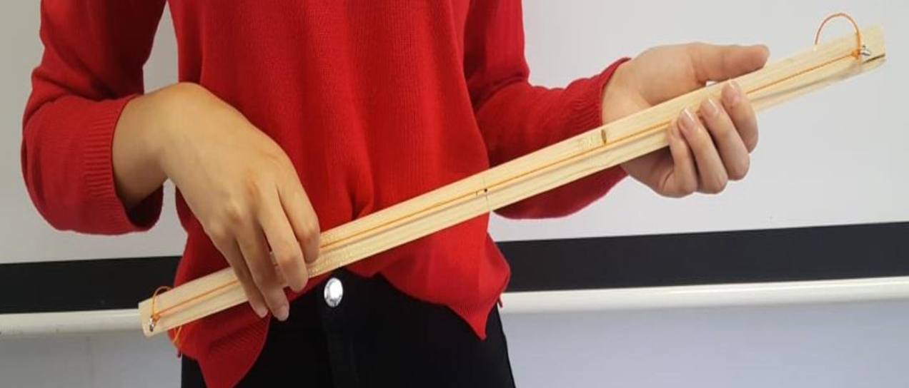
The monochord
In the two previous activities, the oscillation periods were around 1 second, that is a frequency of 1 Hz.
What happens when the string (pendulum) is now tied at both ends? In other words, we are going to study the vibrational patterns of a monochord, one of the oldest known string instruments that was already used by Pythagoras

Slide 26
The monochord
The monochord consists of a wooden stick about 40 to 50 cm long to which we attach a string stretched as tense as possible.
If we tear the string, as if it were a guitar, it will vibrate (oscillate) quickly, in fact hundreds of times per second. It is not possible to measure such oscillation by eye (like in the pendulum). However, the string oscillates so rapidly that produces a sound.
This audible sound tells us that the string is vibrating between 20 and 20,000 times per second (audible range for humans).
This activity consist on finding the relationship between the sound emitted by the monochord and the length of the string (fixing the tension of the string).

Slide 27
The monochord
We can change the length of the string by pressing it down at different distances from one end of the string (as if we were playing a guitar)
The image below represents the time-series of the sound emitted by a monochord (recorded with an audio signal software). The time is shown in seconds. The time-series look like that obtained for the pendulum, although it is more complex. In any case, it is clear that the signal is oscillatory (and damped in time) and the main period of oscillation falls around 0,005 s, that is 200 Hz in frequency.
0,005s

Slide 28
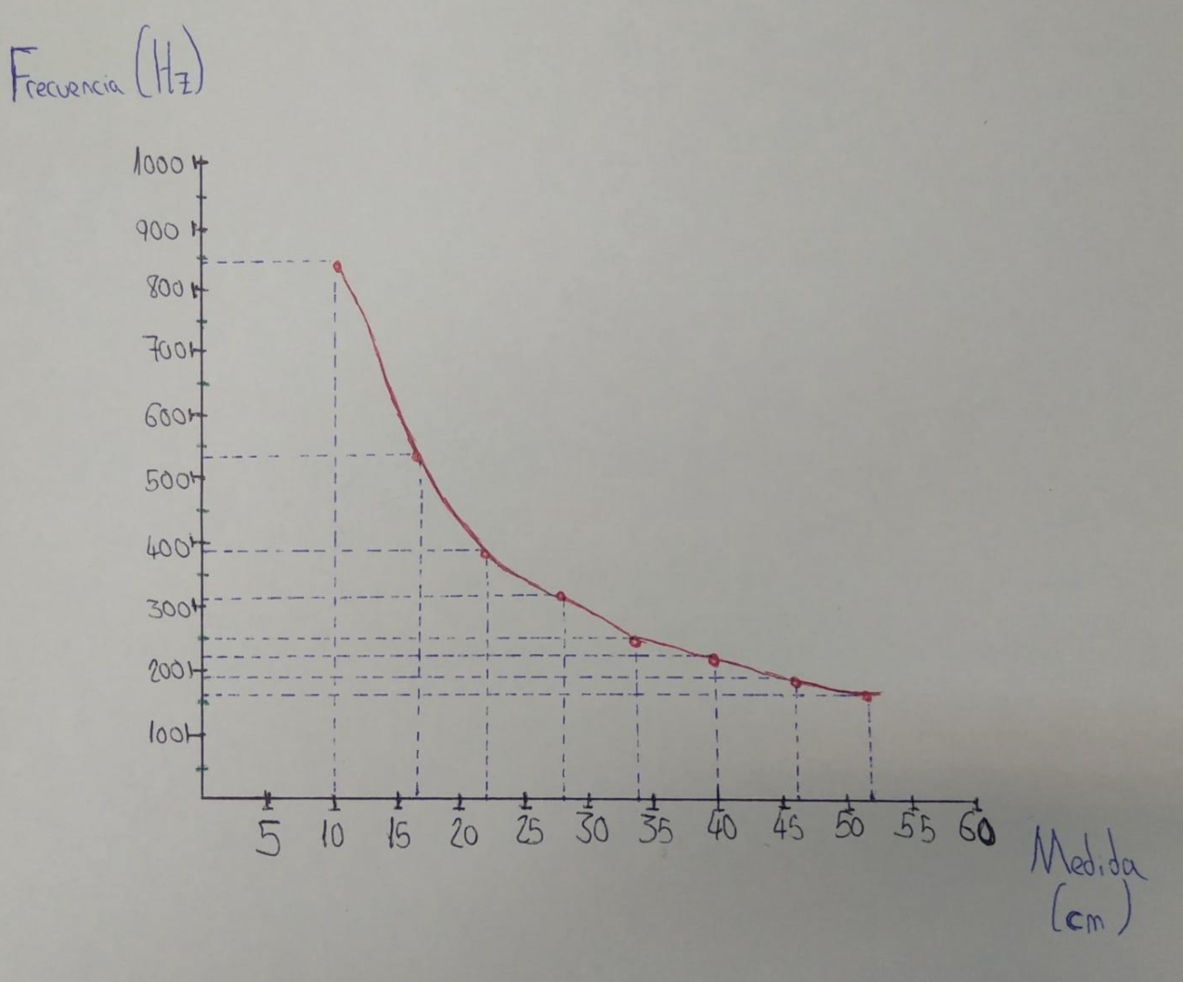
The monochord
It is possible to get a similar result using the ‘pitch’ tab of Goggle Science Journal. It is just necessary to record the pitch while tearing the string
The graph below was obtained by an student from the degree of elementary education at the Universidad de La Laguna. It is represented the frequency of vibration of the thread (pitch) as a function of the length of the thread. This is the relationship (quadratic) we were asking for

Slide 29
The monochord
The velocity of a traveling wave in a stretched string is determined by the tension T and the mass per unit length of the string m. The wave velocity v is given by :
When the wave relationship is applied to a stretched string, it is seen that resonant standing wave modes are produced. The lowest frequency mode f1 for a stretched string is called the fundamental, and its frequency is given by

Slide 30
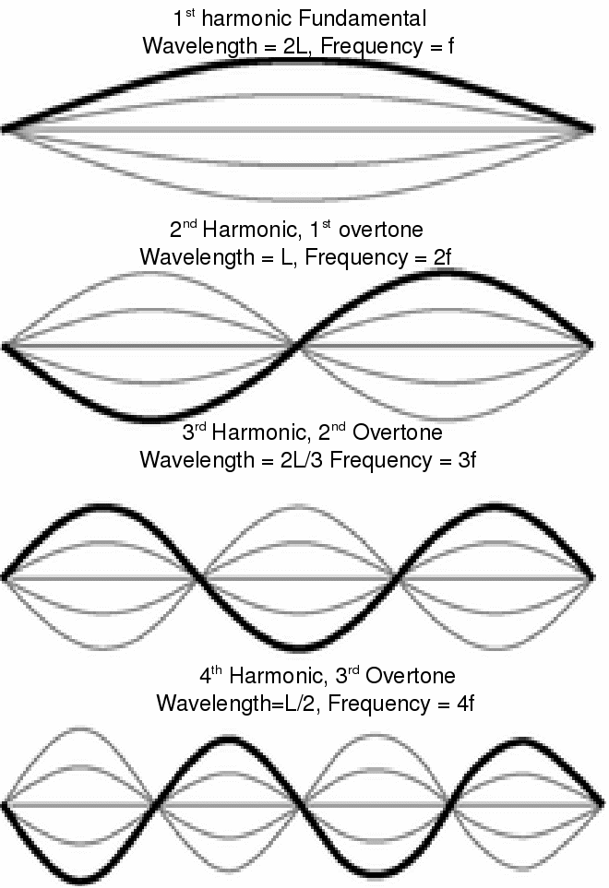
The monochord
From the latter equation, we can see there is a quadratic relation between f1 and L, as seen in the graph.
There is also a unique relation between L, f1 and the spatial pattern of the string vibration
The string will also vibrate at all harmonics of the fundamental. Each of these harmonics will form a standing wave on the string. Harmonics are basically just whole-number multiples of the natural frequency for a given object. For example, if an object's natural frequency is 100 hertz, then its are harmonics are 100 hertz, 200 hertz, 300 hertz, 400 hertz, and so on.

Slide 31
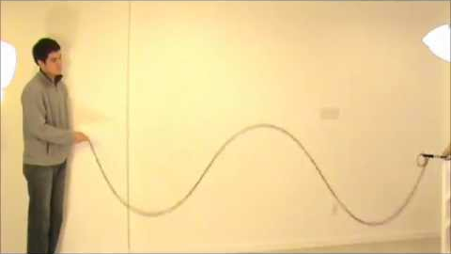
The monochord
Teachers are encouraged to carry out simple demonstrations of standing waves, and harmonics using a rope
Some points of a resonant string do not move during the vibration (nodes), whereas other parts exhibit the largest displacements (antinodes)

Slide 32
The monochord
There is a clear quadratic relationship between the fundamental frequency of oscillation (vibration) of a string and structural properties (length, tension, mass, …). The string will also vibrate at all harmonics of the fundamental. Each of these harmonics will form a standing wave on the string.

Slide 33
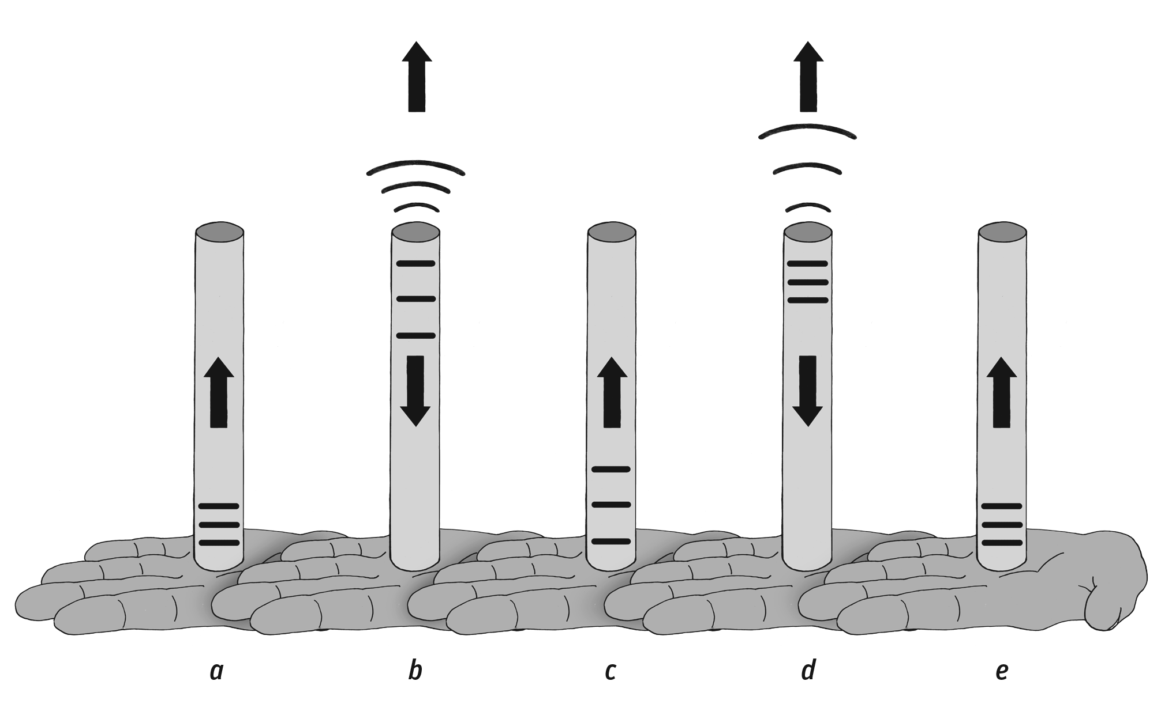
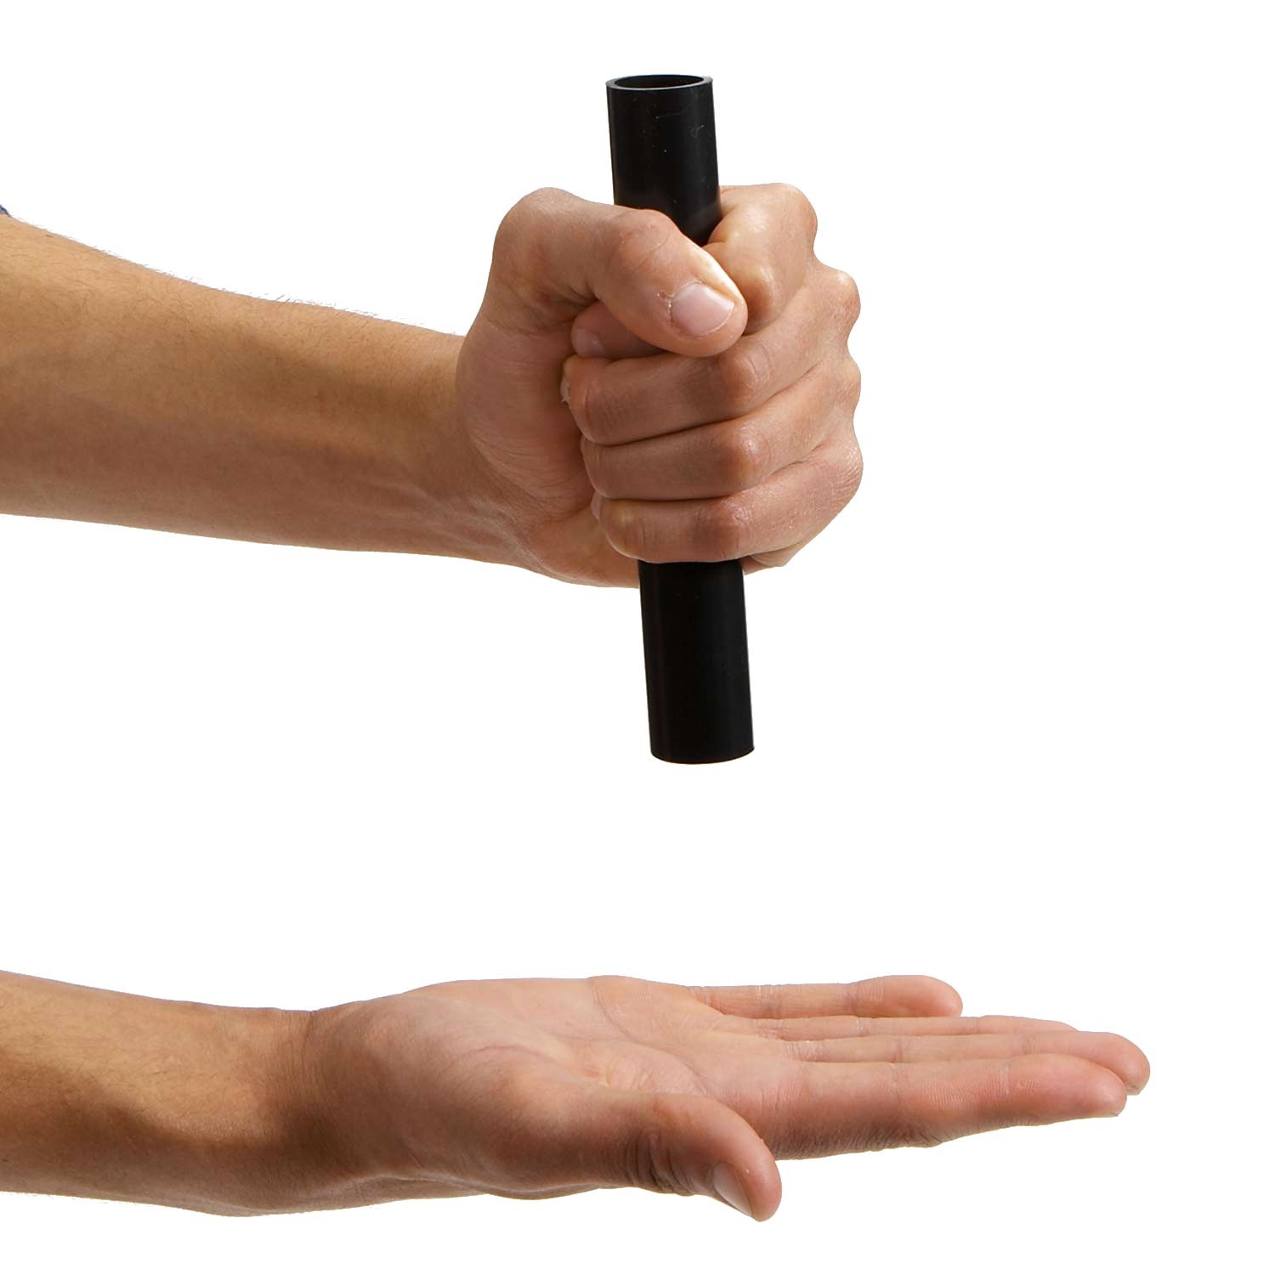
The structure of tubes
When you slap the open end of a pipe onto the palm of your hand, a compression pulse travels upward (a), reflects from the open end as an expansion, and moves back down to your hand (b). The expansion reflects from your hand, travels back up the pipe a second time (c), and comes back to your hand as a compression (d). The process then repeats (e) and an standing wave builds up (like in the case of a string, with nodes and antinodes)

Slide 34
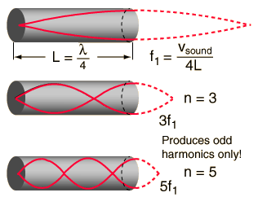
The structure of tubes
The length of the tube matches fractions of the wavelength λ of the standing wave
The length of the tube affects the note the tube produces. Because the speed of sound is the same in all the tubes, the length of the tube has a direct effect on the time it takes for a compression/expansion pulse to make its four transits of the tube. The longer it takes for a pulse to complete its cycle and start over again, the fewer the cycles, or vibrations, per second. The fewer the vibrations per second, the lower the frequency of the sound, and the lower the musical note. Thus, long tubes produce lower notes, and short tubes produce higher notes.

Slide 35
The structure of tubes
For a tube that is open at one end and blocked at the other, resonance first occurs (the fundamental or first harmonic) when the air column is one fourth the wavelength of the sound wave
Experiment 1) If we know the speed of sound in the air (roughly 340 m/s) and measure the pitch of the sound resulting when we hit one end of the tube, it is possible to calculate the length of the tube
Experiment 2) If we know the length of the tube and measure the pitch of the sound resulting when we hit one end of the tube, it is possible to calculate the speed of sound in the air

Slide 36
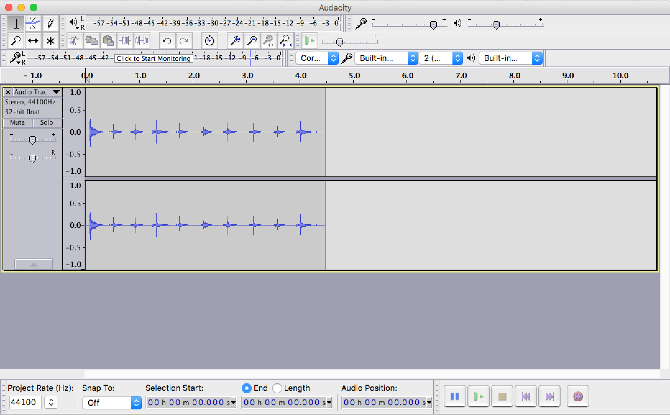
The structure of tubes
Let´s carry out experiment 1)
The sound produced by the tube is too short in time to be analysed by Google Science Journal. We will use the free software Audacity to record the sound and analyses the time series
Start recording with Audacity and slap a few times the open end of a PVC tube (any manageable size). Stop recording.

Slide 37
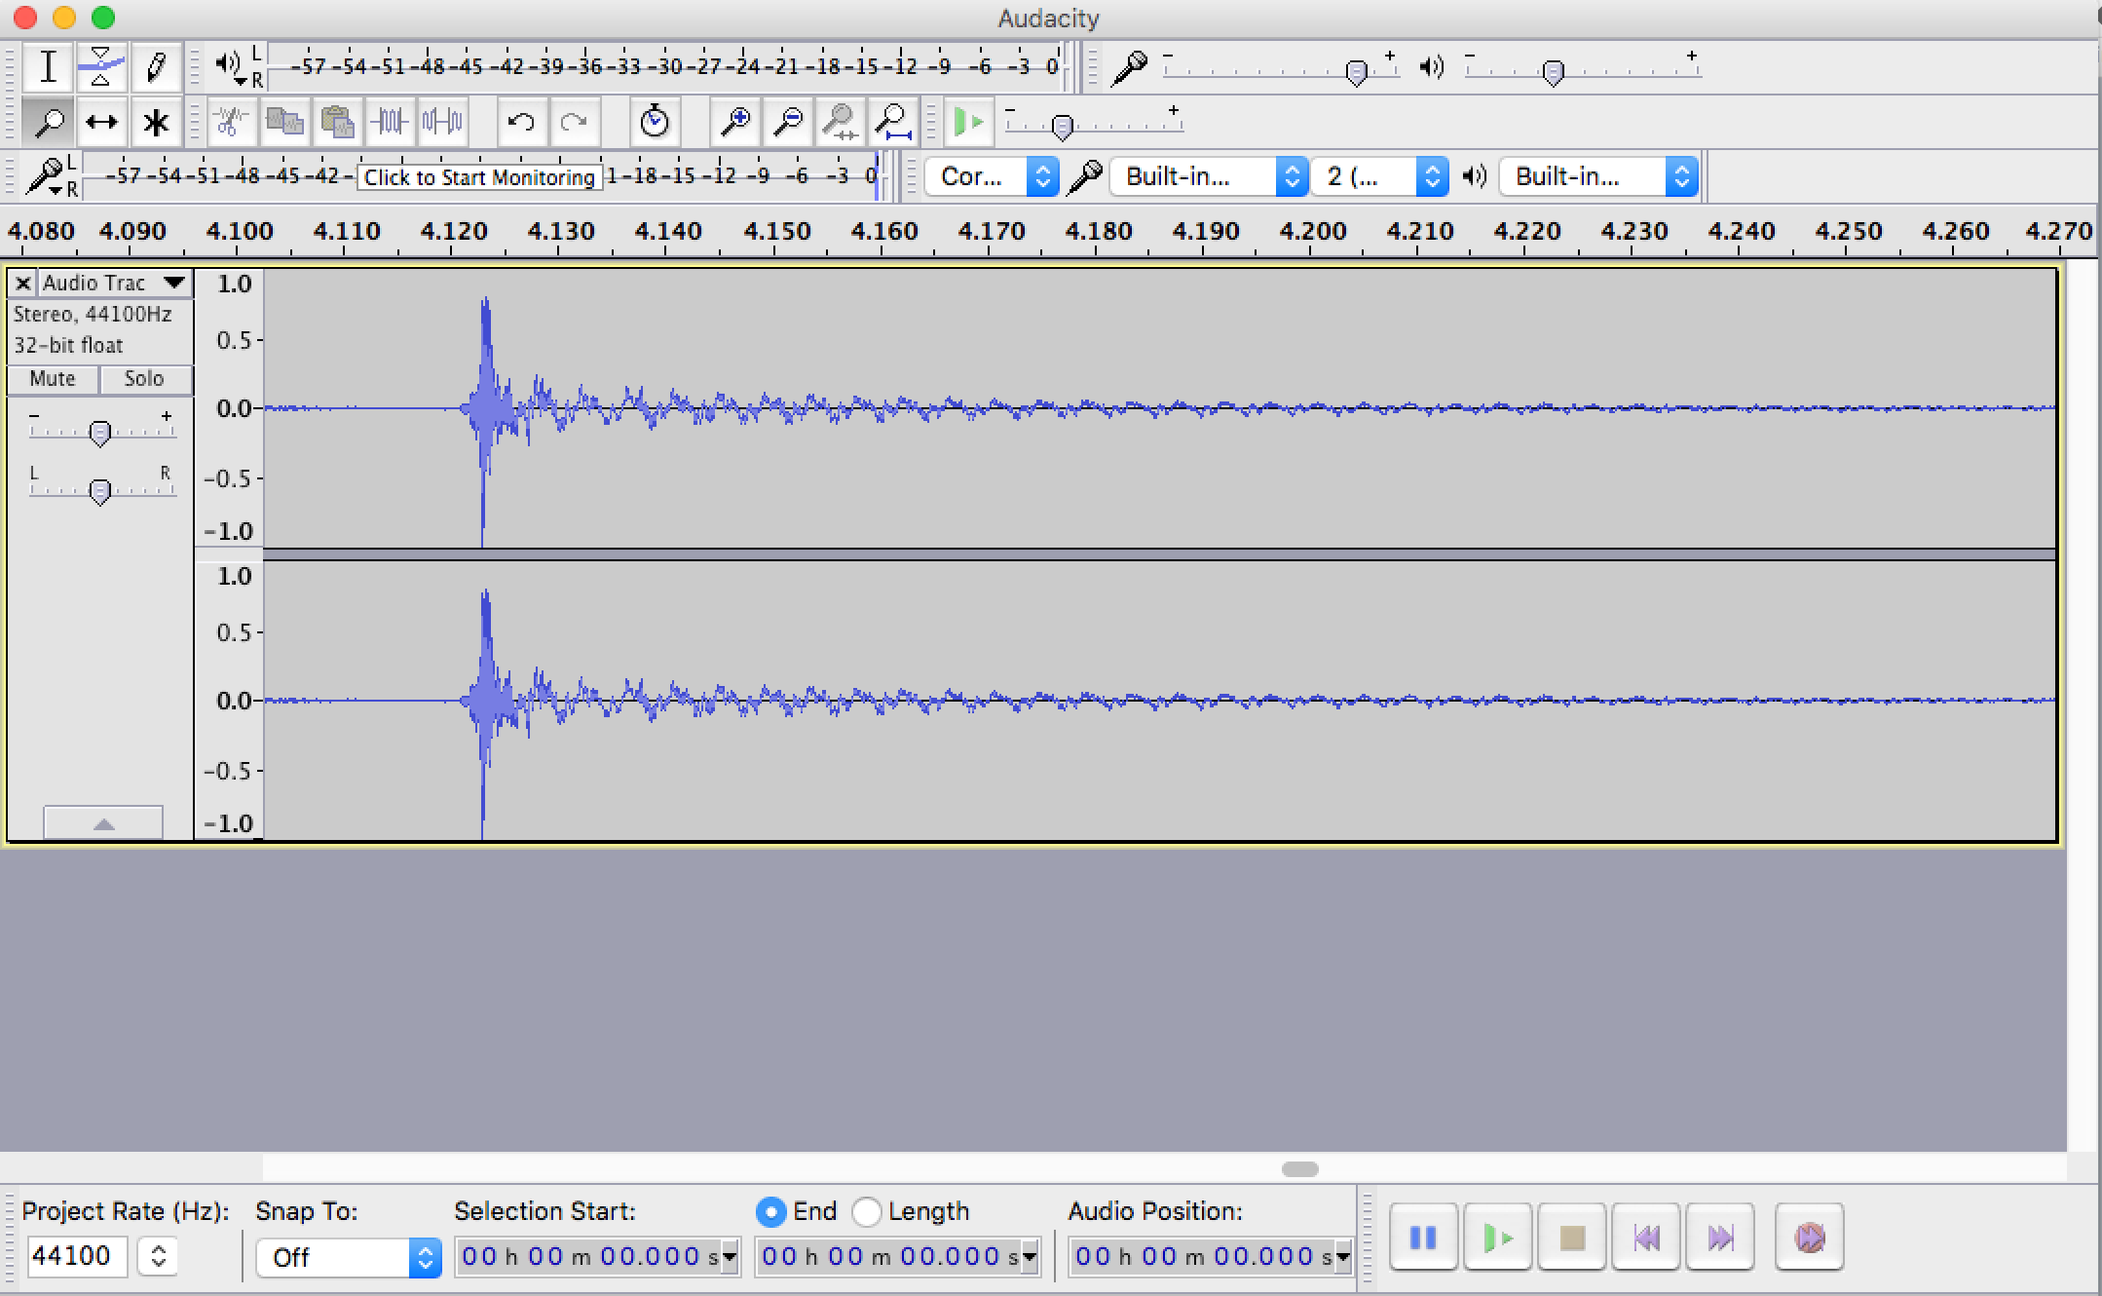
The structure of tubes
Zoom in in one of the sound pulses
The fundamental oscillation is clearly seen in the time series (largest ups and downs pointed by arrows)
The time difference between two ups or downs correspond to the fundamental period of oscillation and its inverse corresponds to the fundamental frequency

Slide 38
The structure of tubes
Once we calculated f1 and since we know the speed of sound vsound (approximately 340 m/s), it is straightforward to calculate the length of the tube L
Students may also measure with a tape the actual length of the tube and compare it with the inference from the sound pitch measurement

Slide 39
The structure of tubes
It is important to stress out that we have calculated the length of the tube by analysing its vibrational properties. This same strategy will be used to obtain structural properties of the sun and other stars just by measuring their vibrational properties
The string vibrates in 1D, the tube in 2D and stars in 3D. However the physical background is the same for all of them.

Slide 40
The structure of tubes
Let´s carry out experiment 2)
Repeat the same steps as in experiment 1). However, in this case we know the length of the tube L and we measured f1. Once again, it is straightforward to calculate the speed of sound vsound
Students may also compare their inferences of vsound with those found in the literature

Slide 41
The structure of tubes
Both experiment 1) and 2) should be carried out using tubes of various lengths
These experiments could also be used as a collaborative activity. Students from Norway could record sound files from PVC tubes and send them to their fellow students in the Canaries and Denmark. The latter should try to calculate the actual length of the test tubes.

Slide 42
The structure of tubes
Standing waves could propagate in 1D (string), 2D (tubes) or 3D (spheres, stars, sun). Analysis of sound time-series induced by the vibration of an air column inside a tube allowed us to calculate structural properties of the system, such as sound speed or the length of the tube.

