Slide 1


Our Star, the Sun
The naked eye

Slide 2
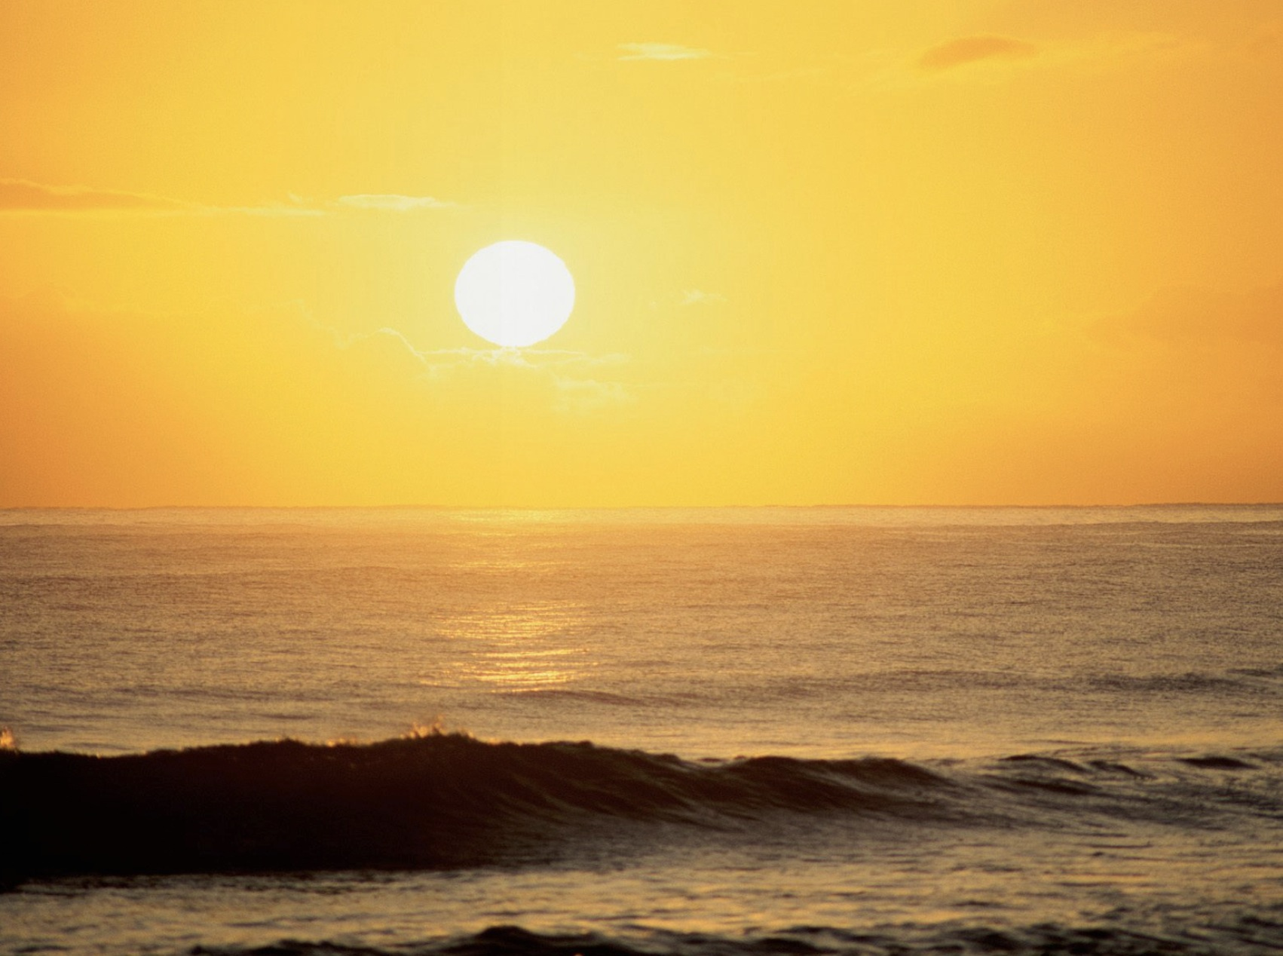
TITLE IN BLUE
Placeholder for text
Bullet point
Table below
Notes:
Implementation:
We are going to make basic observations of the sun
The teacher presents a picture of a sunset and ask students to describe the sun they are watching
The teacher does not give any clues
IP: give some minutes to the students Individually describe the Sun individually, go to Plenum
¿Do students describe the sun by color, size, shape, …?
Let’s see the next photo, where the sun has been coloured in green; reflect with the students how description starts looking for the obvious

Slide 3
TITLE IN BLUE
Placeholder for text
Bullet point
Table below
Notes:
Implementation:
Let’s move to the next photo, where the sun Is not longer round

Slide 4

Notes:
Implementation:
Let’s move to the next photo, where the sun is pouring out material

Slide 5

Notes:
Implementation:
In the final picture, the sun has shrinked

Slide 6
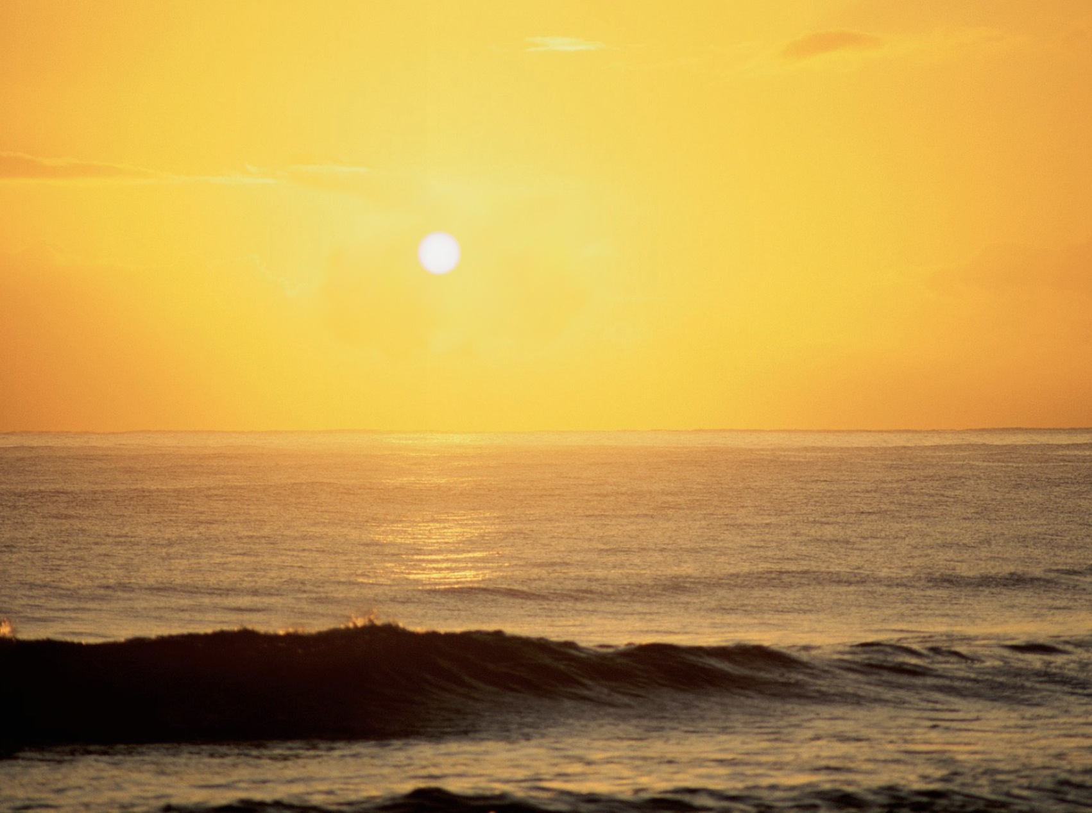

Slide 7
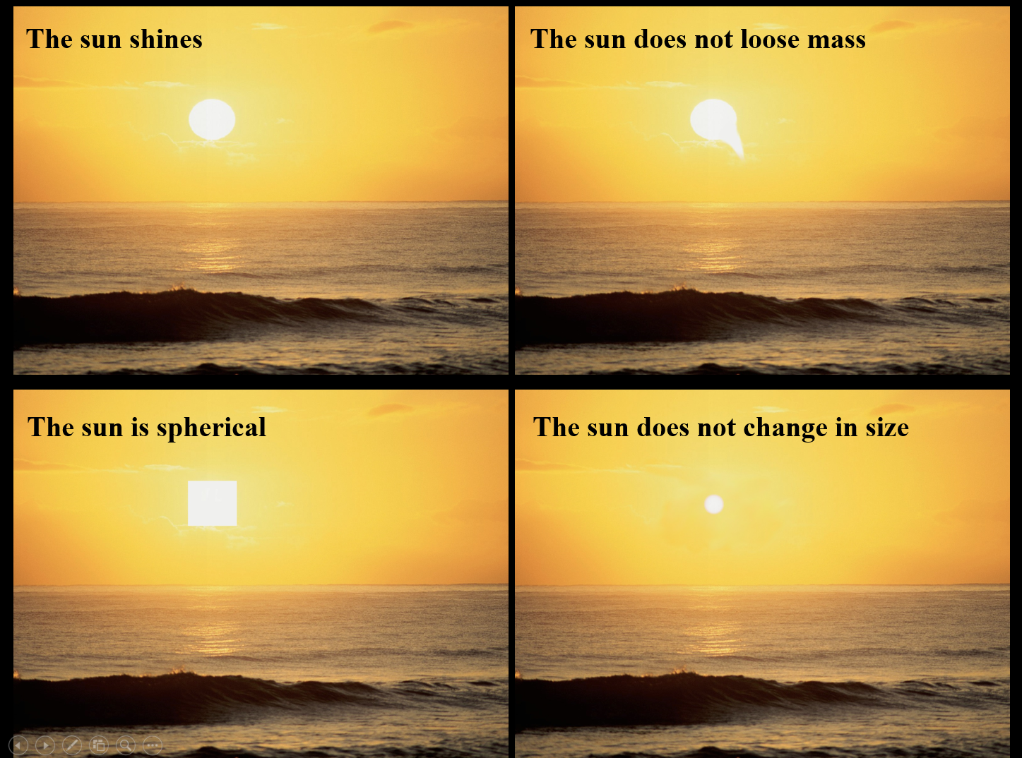
TITLE IN BLUE
Placeholder for text
Bullet point
Table below
Notes:
Implementation:
The teacher presents a summary of the observations
Description is the first step to make science.
IP: Ask to the students if they can add other aspect to describe the sun

Slide 8
TITLE IN BLUE
Placeholder for text
Bullet point
Table below
Notes:
Implementation:
Expectations: GP: ->Question to the students (working groups 2/3) then sharing in Plenum-> Why do you think the Sun is not changing size (stable)?
Science starts formulating a Hypothesis
This is the hypothesis: what we observe is a consequence of the balance between gravity and gas pressure
Let´s try to build a model that fit the observations
The slide above corresponds to the original sunset

Slide 9

Notes:
Implementation:
But this looks too complex. Let us assume the sun is an spherical ball of plasma/gas (simple model)
Question: GP-> Which forces do you think keep the Sun stable?

Slide 10
Notes:
Implementation:
Let us assume the sun is an spherical ball of plasma/gas (simple model)
At any layer of the Sun´s interior…
Question: GP-> Which forces do you think keep the Sun stable?

Slide 11
Gravity
Pressure
Notes:
Implementation:
Let us assume the sun is an spherical ball of plasma/gas (simple model)
At any layer of the Sun´s interior (orange circle) there is a balance between the weight exerted by the layers above it and the pressure of the gas underneath it
Question: I -> Can you think about another things where we found forces equilibrium
Example: balloon (teacher: inflate and close a balloon)
Reflection: GP -> Which forces are here in equilibrium?

Slide 12
Notes:
Implementation:
This balance happens at any layer. The closer to the surface the reference layer is located the lesser the weight of the layers above it and hence the lower the pressure needed to balance the system.
Lower pressure means lower temperature (remember relation between T and P in ideal gases)

Slide 13
Notes:
Implementation:
This balance happens at any layer. The closer to the surface the reference layer is located the lesser the weight of the layers above it and hence the lower the pressure needed to balance the system.
Lower pressure means lower temperature (remember relation between T and P in ideal gases)
The deeper the reference layer is located the higher the weight of the layers above it and hence the higher the pressure needed to balance the system.
Higher pressure means higher temperature

Slide 14
Notes:
Implementation:
We ended up with a model where gas/plasma temperature is significantly higher closer to the core and lower closer to the surface
Since gravity is an isotropic force, the sun gains a spherical shape

Slide 15
5700 ºC
0.07 atm
15x10⁶ ºC
2.3x10⁶ atm
Notes:
Implementation:
We ended up with a model where gas/plasma temperature is significantly higher closer to the core and lower closer to the surface
Since gravity is an isotropic force, the sun gains a spherical shape

Slide 16
Hydrostatic equilibrium
Pressure
Gravity
  dp=−ρgdz
Notes:
In the case of the Sun this is called Hydroestatic equilibrium.
We use equations to write this behaviour. In this case the words explaining that gravity and presssure are in equilibrium are written as you can see above.
Mathematics is the language of the science!

Slide 17
Conceptual map of the sun
Spherical shape
Gravity
acts on
Contraction
Tends to
Gas/plasma
Balance and stability
heats up
Tends to
Energy source
Expansion
Notes:
Implementation:
The next slides corresponds to a conceptual map of the basic model that has been built
In order to obtain results from the model and compare them with actual observations, we need to ‘translate’ the conceptual model into maths
Besides the equation for hydrostatic equilibrium, equations describing the generation and transport of energy and the distribution of mass should be derived (out of the scope of this lesson)
These mathematical equations could be resolved by a computer code.

Slide 18
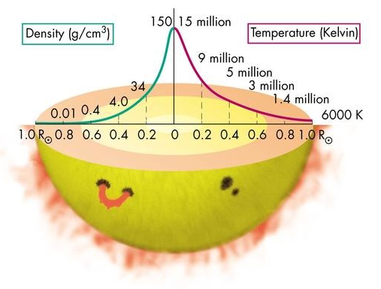

Slide 19
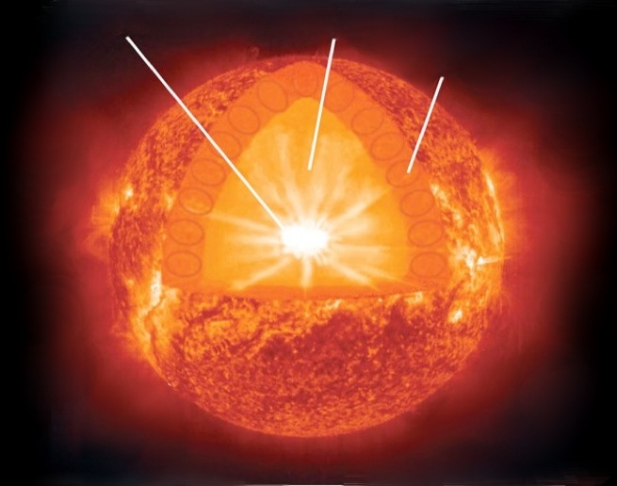
Core
Radiative zone
Convective zone
Notes:
Implementation:
The next slides corresponds to a conceptual map of the basic model that has been built
In order to obtain results from the model and compare them with actual observations, we need to ‘translate’ the conceptual model into maths
Besides the equation for hydrostatic equilibrium, equations describing the generation and transport of energy and the distribution of mass should be derived (out of the scope of this lesson)
These mathematical equations could be resolved by a computer code.
Due to the distribution of density, pressure and temperature, the sun could be split into three regions: the core, the radiative zone and the convective zone.
Question/reflection: GP -> Work in groups of 2/3 and think about the following question:
(1) What happens if our supercomputer running the model calculates a value for the Temperature of the Sun in the surface slightly different from the observations using a old telescope and detector: What we should check: measurement device, model, both? Why?
(2) Measurements vs Models: what is more important in the scientific method?
(3) Can you name other methods where the model is more important than the measurements?

