Slide 1
Our Star, the Sun
Energy Bill - Introduction

Slide 2
Activity I: naked eye
How to build a physical model of the sun
Activity II: energy bill
How to build a physical model of the sun
Sources of energy in the sun
Module I: Our star, the sun
Activity III: oscillations
The vibrational properties of physical bodies are related to
their internal structure and dynamics
The sun and other stars vibrate/oscillate
Activity IV: solar and
stellar oscillations
To measure solar and stellar oscillations
To extract information on the solar internal structure from its
oscillatory properties
To learn how to move from the time-domain to the frequency-domain
Notes:
How to build a physical model of the sun
Sources of energy in the sun

Slide 3
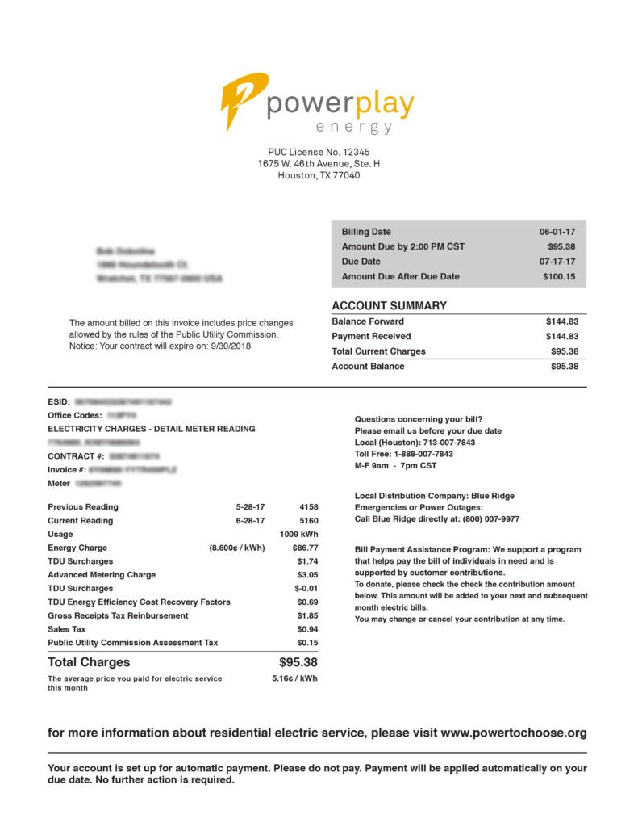
Notes:
An electrical bill is presented to the students

Slide 4
1009 kWh
in 1 month
Notes:
The teacher explains how to convert the data in the bill to power consumption (in watts)

Slide 5
1356 W
Notes:
The power generated by the sun is then overlapped in the slide in order to catch the attention of the students

Slide 6
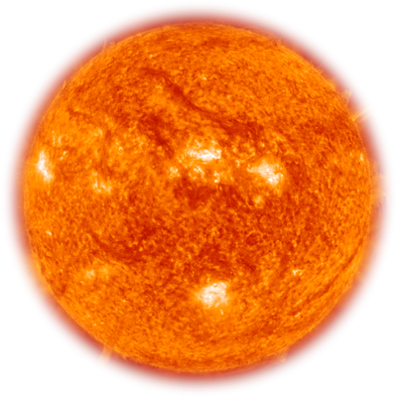
L_{o}= 4x10²⁶ W
1356 W
Notes:
How is the sun emitting such huge amount of energy?
We are going to build some physical models to try to explain it

Slide 7
L_{o}= 4x10²⁶ W
There is a ‘challenge’ activity called ‘Sun app’ to measure the luminosity of the Sun with an smartphone

Slide 8
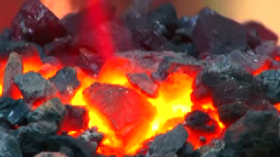
Implementation
The lifetime of the Sun is determined by
– How fast the Sun consumes the fuel: Luminosity of the Sun
– The type of fuel: Chemical (coal)
– How much fuel the Sun contains: Mass of the Sun

Slide 9
If the Sun were made of C and O₂, 3.67g of CO₂ would release 33,94kJ. Hence 2x10³³ g would release 2x10³⁷ J
Lifetime = (Amount of Fuel)/(How Fast the Fuel is Consumed)
Lifetime = (2 x 10³⁷ J)/(3.8 x 10²⁶ J/s) = 1.1 x 10¹¹ seconds.
Therefore, the Sun lasts for ~3200 years, if coal is the fuel.

Slide 10
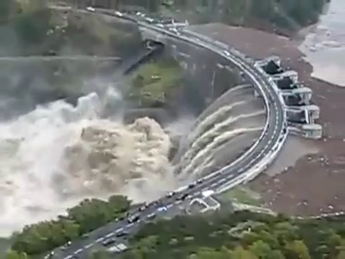
Implementation
The lifetime of the Sun is determined by
How fast the Sun consumes the fuel: Luminosity of the Sun
The type of fuel: Gravitational energy
How much fuel the Sun contains: Mass of the Sun

Slide 11
Gravity can generate energy.
– A falling body acquires velocity from gravity.
– Gravitational energy = (3/5)GM²/R
– The radius of the Sun: R = 7 x 10⁸ m
– Gravitational energy of the Sun = 2.3 x 10⁴¹ Joules.
Lifetime = (Amount of Fuel)/(How Fast the Fuel is Consumed)
Lifetime = (2.3 x 10⁴¹ J)/(3.8 x 10²⁶ J/s) = 6 x 10¹⁴ seconds.
Therefore, the Sun lasts for ~20 million years, if gravity is the fuel
Notes:
This figure is very similar to that obtained by Lord Kelvin, regarding the age of the Earth. This is a very interesting story that teachers might discuss. Since the age of our planet is approximately 4500 million years and the ages of the sun and Earth must be of the same order of magnitude, we are missing something in our energy model.

Slide 12
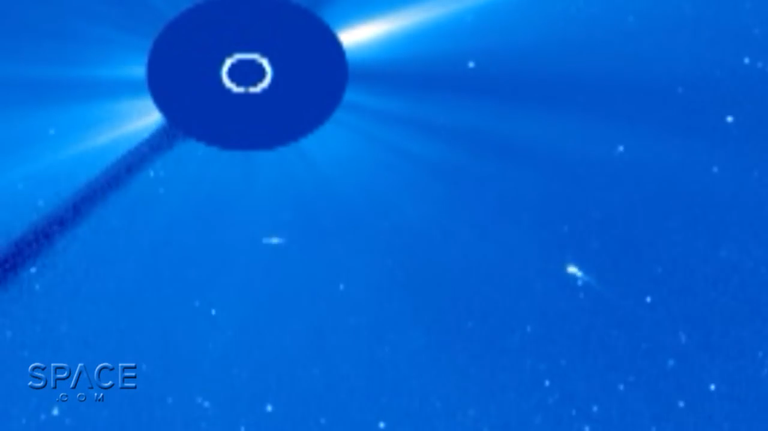

Slide 13
Implementation
Depending on the skills of the students, a challenging problem might be proposed
A short video of a comet falling into the sun is presented
Students are asked to calculate the ‘mass of comets’ that have to impact the Sun (very simplistic model) in order to obtain the total solar luminosity from the energy released from impacts.
Students are asked to define the problem and the initial conditions, recalling it must be solved through conservation of total energy (kinetic and potential)

Slide 14
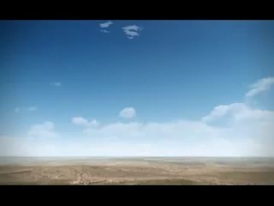
Implementation
The lifetime of the Sun is determined by
– How fast the Sun consumes the fuel: Luminosity of the Sun
– The type of fuel: Nuclear energy
– How much fuel the Sun contains: Mass of the Sun
Tzar bomb

Slide 15
Sun basically made of protons, ¹H
Energy released from the fusion of protons
¹H + ¹H -> ²H + e⁺ + ν_{e}
²H + ¹H -> ³He + γ
³He + ³He -> ⁴He + ¹H + ¹H
(¹H: proton, ²H: deuteron, ³He: Helium-3, ⁴He: Helium-4, e⁺: positron, ν_{e}: neutrino, γ: gamma ray)
In total, four protons are fused into one helium-4 and produce energy
¹H + ¹H + ¹H + ¹H -> ⁴He + “binding energy”
One proton weighs 1.6726 x 10⁻²⁷ kg
One helium-4 weighs 6.643 x 10⁻²⁷ kg
Four protons minus one helium = 4.7 x 10⁻²⁹ kg -> energy
• This is 0.7% of the mass of four protons are converted into energy

Slide 16
• Einstein’s Energy Formula: E=Mc²
– The mass itself can be the source of energy
– Mass energy = 0.0007 x 1.8 x 10⁴⁷ J, if mass is converted into energy
Lifetime = (Amount of Fuel)/(How Fast the Fuel is Consumed)
Lifetime = (1.26 x 10⁴⁴ J)/(3.8 x 10²⁶ J/s) = 3,3 x 10¹⁷ seconds.
Therefore, the Sun lasts for ~ 10 x 10⁹ years, if mass is the fuel.

Slide 17
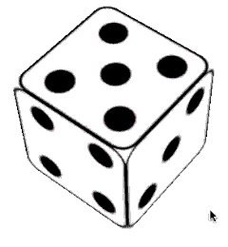
However …
¹H + ¹H is impossible due to electromagnetic repulsion, but it happens
The answer lies in quantum mechanics, in which protons stop having an objective existence, and start obeying laws of distributed probability - i.e there is a non-zero probability of finding the proton (almost) in any given region in space. Therefore there is a finite probability (3 x 10⁻¹⁸) that at any given moment, a proton will quantum tunnel 'inside' another proton, which allows fusion to take place.
This probability could be considered ‘zero’ in normal circumstances. Try to toss at once 23 dice and get the numerical sequence below. Your chances are ~3 x 10⁻¹⁸
Extremely low chances for two protons to fuse, but there are
~10⁵⁷ protons in the Sun, hence ~10³⁸ fusions per second
1 2 3 4 5 6 1 2 3 4 5 6 1 2 3 4 5 6 1 2 3 4 5

