Slide 1
Our Star, the Sun
Solar Stellar Observations

Slide 2
Activity I: naked eye
How to build a physical model of the sun
Activity II: energy bill
How to build a physical model of the sun
Sources of energy in the sun
Module I: Our star, the sun
Activity III: oscillations
The vibrational properties of physical bodies are related to
their internal structure and dynamics
The sun and other stars vibrate/oscillate
Activity IV: solar and
stellar oscillations
To measure solar and stellar oscillations
To extract information on the solar internal structure from its
oscillatory properties
To learn how to move from the time-domain to the frequency-domain

Slide 3
Activity IV
Solar and stellar oscillations

Slide 4
Solar and stellar oscillations
Outline
Fast facts
Students will learn
Curricular connections
Resources
Implementation

Slide 5
Outline
This set of activities are intended to explain the connection between the vibrational patterns of the sun and other stars and its internal structure and dynamics.

Slide 6
Fast facts
Age range: Secondary
Type of module: Classroom activity
General Curriculum links: All areas of science
Complexity: Medium
Time required: 3-4 class sessions
Location: Classroom and observatory
Includes the use of: Computer
Methodology: Direct instruction and hands on

Slide 7
Students will learn
The basics of the scientific method
To look for patterns in nature
How a physical model is built
Use concepts like: oscillations, frequency, resonance, …

Slide 8
Resources
Computer and projector
Software to present slides (ppt or similar)
Audacity, Past3

Slide 9
The activities
CSI-Fourier: understand the concept of Fourier Analysis, this is, to decompose any time-series as a combination of basis distributions from where significant information of the temporal evolution of the series might be extracted
The tool: introduction of spectral analysis of time-series
The observatory: during the visit to El Teide observatory, we will learn how to measure oscillations in the sun and stars
From PVC tubes to red giants: We will calculate the main periods of oscillation of the sun and other stars and will attempt to relate them with the main structural parameters of the stars. The PVC tubes will be used as a good approximation to the structure of stars

Slide 10
CSI - Fourier
Frequency and period
The meaning of Fourier analysis
The tool
To understand how to carry out Fourier analysis
To learn how to extract information from Fourier analysis
Activity IV: solar and stellar oscillations
The observatory
How to measure oscillations in the sun and stars
From PVC tubes to
red giants
Calculate spectral properties of the sun and other stars
Understand how to relate oscillations and structural parameters of the stars

Slide 11
CSI - Fourier
In this activity we explain how a spatial or temporal distribution could be represented as a combination of a series of ‘basis distributions’
An scene from the TV show ‘CSI Las Vegas’ is presented to the students
A face recognition computer software is used to try to identify a murder suspect

Slide 12
CSI - Fourier

Slide 13
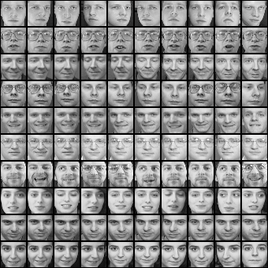
CSI - Fourier
This software collects thousands of ‘training images’ from people with different ages, races, ‘moods’, genders, …
M. Turk, A. Pentland, "Eigenfaces for Recognition", Journal of Cognitive Neuroscience, 3(1), pp. 71-86, 1991.

Slide 14
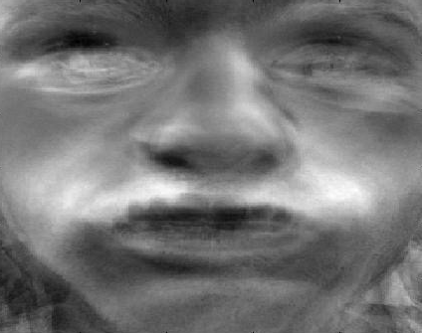
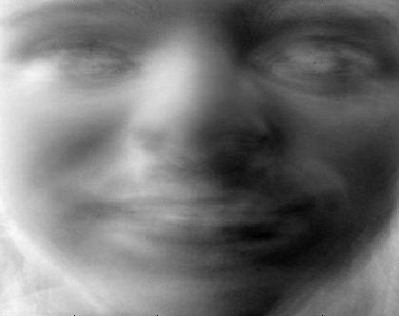
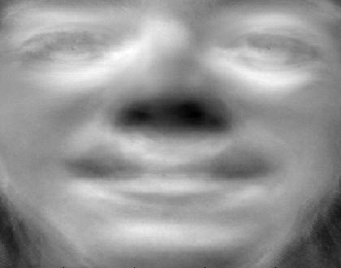
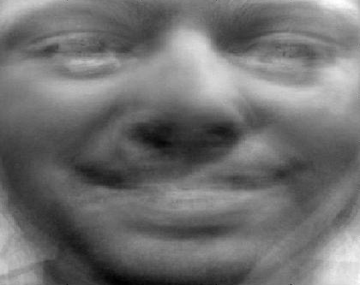
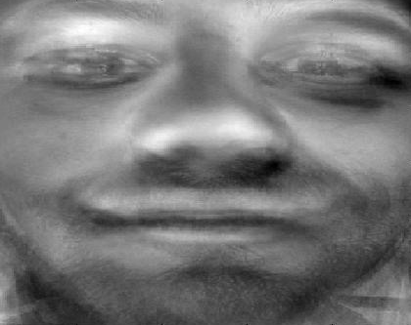
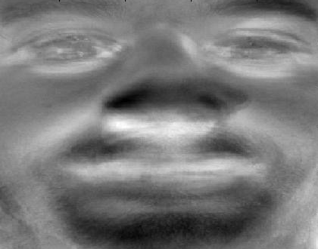
CSI - Fourier
From the analysis of all these images, a set of ‘basis faces’ are obtained
Any actual face might be obtained from a combination (with weights Wi) of just 6 ‘basis faces’
Basis faces

Slide 15
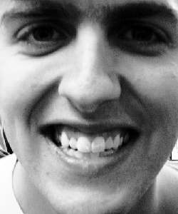
Actual face
=
W1
*
+
W2
*
+
Weights
W3
*
Basis faces
+
W4
*
+
W5
*
+
W6
*
Jeremy Wyatt

Slide 16
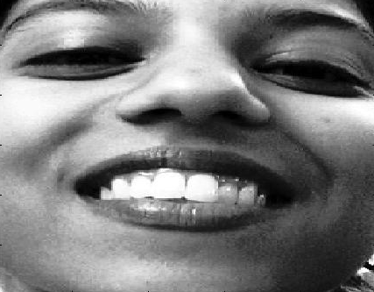
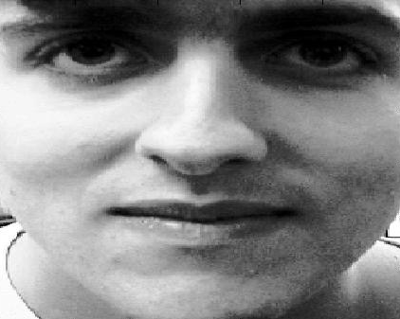
Actual face
=
W1
*
W1
= - 8029
W1
= - 1183
+
W2
*
W2
= 2900
W2
= - 2088
+
W3
*
W3
= 1751
W3
= - 4336
+
W4
*
W4
= 1445
W4
= - 669
+
W5
*
W5
= 4238
W5
= - 4221
+
W6
*
W6
= 6193
W6
= 10549
Jeremy Wyatt

Slide 17
CSI - Fourier
The weight given to every ‘basis face’ will give information about gender, mood, ….
It is possible to characterise any face by the distribution of the weights of the ‘basis faces’
Faces are spatial distributions, but the same idea lies behind the representation of time-series
It is possible to represent a time-series as a combination of some basis time-series

Slide 18
Actual time-series
=
W1
*
+
W2
*
+
Basis time-series
Weights
W3
*
+
W4
*
+
W5
*
+
WN
…

Slide 19
CSI - Fourier
The basis time-series correspond to sine waves with different frequencies (cycles per second) and amplitudes (given by the weights)
The decomposition of any time-series in a combination of sine waves with different frequencies and amplitudes is called Fourier Analysis

Slide 20
CSI - Fourier
Another visual example of Fourier Analysis
Basis time-series
Weights (amplitude)
Actual time-series
http://pgfplots.net

Slide 21
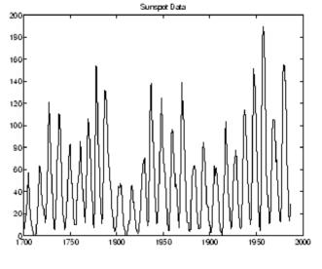
CSI - Fourier
A real example: the time-series correspond to the variation of the number of sunspots on the solar surface from 1700 to 2000, this is, nearly 300 years
http://sciences4shared.blogspot.com

Slide 22
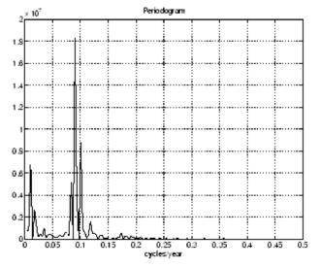
CSI - Fourier
Fourier Analysis is usually represented in an X-Y graph: in the x-axis the frequencies (cycles per year in this case) of the basis time-series (the sine waves) and in the y-axis the corresponding weights (amplitudes)
Weights of the basis time-series
Frequencies of the basis time-series
http://sciences4shared.blogspot.com

Slide 23
CSI - Fourier
In this case, the largest weights are found around 0.1 cycles per year; in other words, the most significant period is found around 11 years. Hence, the most significant temporal variation of sunspots correspond to a cycle of around 11 years

Slide 24
The tool
We will learn how to use numerical tools to carry out Fourier analysis. In particular the software PAST3 https://folk.uio.no/ohammer/past/
Fourier analysis will be applied to a set of actual time-series in order to learn how to extract spectral and physical information from this tool

Slide 25
The observatory
During the visit to El Teide observatory, students will learn the basics of helioseismological and asteroseismological observations
Students will learn about the physics behind these kind of observations

Slide 26
From PVC tubes to red giants
We will calculate the radius and mean densities of a set of stars using information from the Fourier analysis
Coming soon ….

